Slide 2
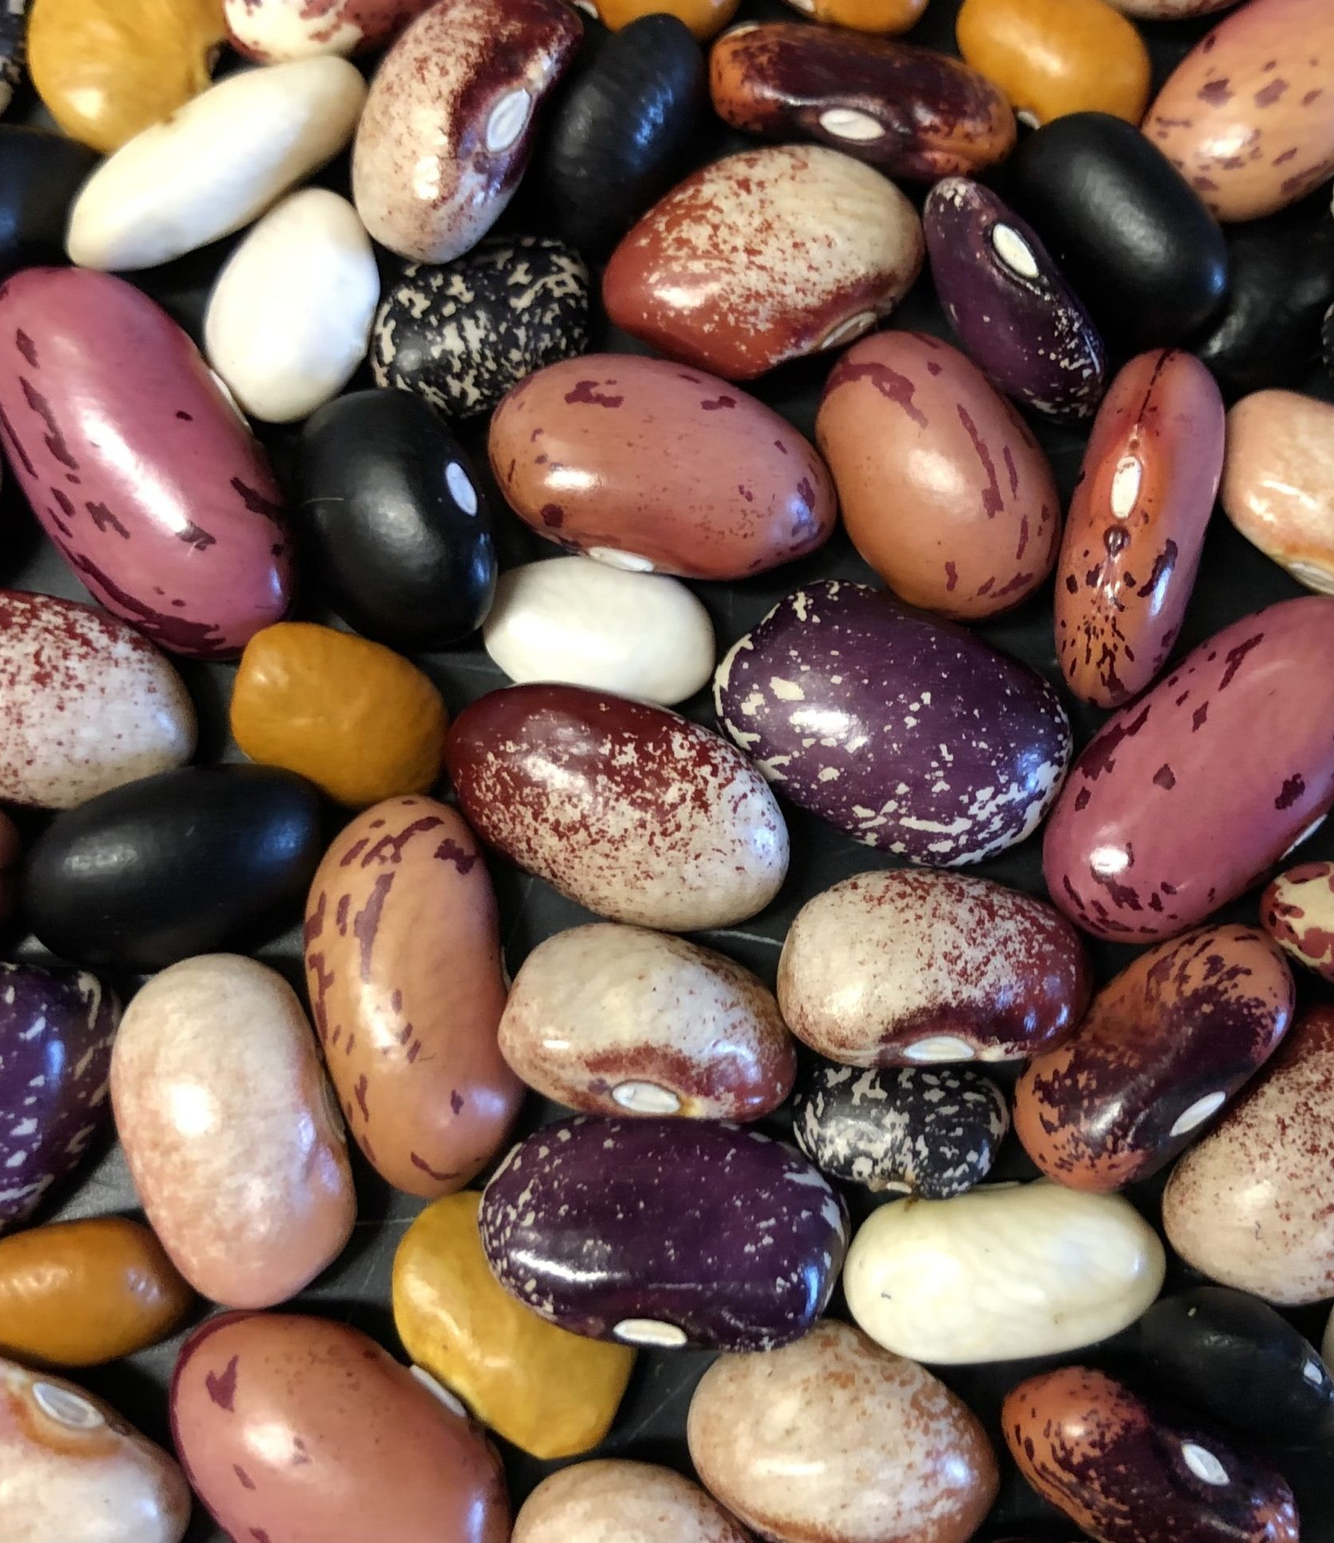
ALL ABOUT HEIRLOOM BEANS
Unlike commercial beans bred for high yields and uniformity, heirloom bean varieties are cherished for their rich flavors, vibrant colors, and deep cultural roots that are often passed down for generations within families or communities. Each type has a story, reflecting the culinary traditions and agricultural heritage of specific regions around the world.
Historically, beans have been a staple in human diets for thousands of years. Archaeological evidence shows that beans were cultivated in the Americas as early as 7,000 years ago, particularly in Mesoamerica and the Andes. Many heirloom varieties today descend from these ancient lineages, preserved by Indigenous communities and small-scale farmers who selected for flavor, nutrition, and climate resilience rather than mass production traits. These beans became deeply embedded in local foodways, adapted to diverse microclimates and soil conditions.
Heirloom beans are typically grown using traditional, sustainable methods that emphasize biodiversity and seed preservation. As open-pollinated plants, they allow farmers to save seeds each season, maintaining regional traits and genetic diversity. Grown as bush or pole types depending on the variety, they require little more than sun, water, and support, and often thrive in organic or regenerative systems.
Production remains small-scale and hands-on, with harvesting, drying, and shelling often done manually to protect quality and seed viability. After drying, beans are stored in breathable containers and sold through farmers markets, specialty retailers, or seed-saving networks, rather than mass-market channels.
Beyond their nutritional value, heirloom beans are prized by chefs for their complex textures and ability to elevate simple dishes. In an age of agricultural uniformity, they represent a flavorful act of preservation and a connection to the past, reminding us that diversity on the plate begins with diversity in the field.
ACF IOTM
JUNE 2025
HEIRLOOM BEANS

Slide 3
HEALTHY INGREDIENT CONTRIBUTION
Heirloom beans such as cranberry, Jacob's Cattle, Anasazi, Scarlet Runner, and Yellow Eye are nutrient-dense legumes that provide a powerhouse of fiber, protein, vitamins, and minerals. Their nutritional profile supports heart health, blood sugar regulation, digestive wellness, and sustainable energy. Although nutritional values may vary slightly by variety, the general nutritional profile of 1 cup (approx. 170g) of cooked heirloom beans is comprised of:
Calories: 240
Calories provide energy and fuel for every bodily function from thinking to physical activity
Protein: 15g (30% DV)
Protein builds and repairs tissues, including muscle, skin, and organs as well as being important for enzyme and hormone production
Dietary Fiber: 15g (54% DV)
Dietary fiber supports digestion by promoting healthy bowel movements and helps reduce cholesterol, controls blood sugar, and supports long-term heart and gut health
Total Fat: 1g (1% DV)
Fat provides energy, helps absorb fat-soluble vitamins, protects organs, and is essential for brain function and hormone production
Carbohydrates: 40g (15% DV)
Carbohydrates are a primary source of energy for the brain and muscles and are digested slowly which helps with energy stability and blood sugar control
Iron: 4.5mg (25% DV)
Iron is essential for making hemoglobin (transports oxygen in the blood), helps prevent fatigue, and supports immune function
Magnesium: 85mg (20% DV)
Magnesium is involved in over 300 biochemical reactions including muscle/nerve function, blood sugar control, and blood pressure regulation
Potassium: 750mg (16% DV)
Potassium helps regulate fluid balance, muscle contractions, and nerve signals
Folate (Vitamin B9): 300mcg (75% DV)
Folate is crucial for DNA synthesis and cell division, both of which are very important during pregnancy
Zinc: 2.2mg (20% DV)
Zinc supports immune function, wound healing, DNA synthesis, cell growth, helps fight infection, and supports healthy skin and vision
Calcium: 60mg (5% DV)
Calcium is vital for building and maintaining strong bones/teeth and helps support muscle function, nerve signaling, and heart rhythm
Nutritional Information/Values from USDA FoodData Central
ACF IOTM
JUNE 2025
HEIRLOOM BEANS

Slide 4
TYPES AND VARIETIES
Heirloom beans offer distinct taste and texture, reflect regional food traditions, and support genetic diversity and resilient farming systems, making them a flavorful, culturally rich, and sustainable choice. Listed below are some of the most popular and unique heirloom bean varieties:
Cranberry Beans (Borlotti)
Appearance: Creamy beige with maroon speckles
Flavor: Mild, nutty, slightly sweet
Origin: Popular in Italy and Latin America
Anasazi Beans
Appearance: Red and white spotted beans
Flavor: Sweet, mild, meaty texture
Origin: Named after Ancestral Puebloans of the S.W. U.S.
Jacob’s Cattle Beans
Appearance: Red with white spotting
Flavor: Rich, earthy, robust
Origin: Early settlers in the Northeastern U.S.
Scarlet Runner Beans
Appearance: Large, black-purple with pink streaking
Flavor: Nutty, meaty, dense bite
Origin: Native to Central America
Yellow Eye Beans
Appearance: Creamy white with a mustard-colored “eye”
Flavor: Mild, buttery
Origin: Deep roots in New England
Tiger’s Eye Beans
Appearance: Golden yellow with swirls of reddish-brown
Flavor: Creamy texture, hint of sweetness
Origin: Popular in Chilean cuisine
Good Mother Stallard Beans
Appearance: Deep burgundy with specks of white
Flavor: Full-bodied, earthy
Origin: Named after a Southern U.S. seed keeper
Black Turtle Beans
Appearance: Small, shiny, and black
Flavor: Dense, meaty, sweet finish
Origin: Staple in Caribbean and Latin cuisines
King of the Early Beans
Appearance: Plump, red-speckled
Flavor: Smooth, rich
Origin: New England
Rattlesnake Beans
Appearance: Green/purple (fresh) or tan/brown (dried)
Flavor: Sweet, tender
Origin: Grown traditionally in the American South
ACF IOTM
JUNE 2025
HEIRLOOM BEANS

Slide 5
SELECTING AND STORING
Selecting Heirloom Beans:
Look for Vibrant Color and Uniform Shape
Heirloom beans should have rich hues and distinctive markings. Faded or cracked beans may be older and slower to cook.
Feel the Beans
Beans should be hard and dense to the touch. If they crumble or feel chalky, they’ve aged out of their prime.
Buy from Trusted Sources
Look for growers or retailers who specialize in heirloom or organic varieties as freshness and traceability make all the difference.
Check the Harvest Date
Ideally, you want beans harvested within the past 12–18 months for best flavor and cookability.
Storing Heirloom Beans:
Keep Beans in a Cool, Dry Place
Store your beans in a pantry away from sunlight and moisture.
Use Airtight Containers
Store beans in glass jars, tins, or BPA-free containers to protect against humidity and pests.
Label with Variety and Purchase Date
Proper labeling helps track freshness especially if you’re building a collection of bean varieties.
Prime Flavor and Texture
Beans will have the best flavor and texture if consumed within 1-2 years from harvest but are safe to eat for much longer.
Freeze for Long-Term Storage
To preserve freshness and prevent pantry pests, you can freeze dry beans in airtight containers for up to 3 years.
ACF IOTM
JUNE 2025
HEIRLOOM BEANS

Slide 6
CULINARY USES
Heirloom beans are so much more than a humble pantry staple, they’re culinary rock stars that bring bold flavor, creamy texture, and deep heritage to every dish. Their diversity makes them perfect for both rustic comfort food and elegant, chef-driven creations.
Soups & Stews: Heirloom beans hold their shape beautifully and soak up surrounding flavors making them natural stars in brothy, hearty dishes.
Salads: Adding a creamy texture and a protein punch to cold dishes, heirloom beans and their brilliant colors can make any salad pop.
Baked Beans & Casseroles: Heirloom beans like Yellow Eye and King of the Early are ideal for slow baking by offering rich, buttery flavors that intensify over time.
Purees, Dips, & Spreads: Blended heirloom beans make flavorful dips and spreads that will give hummus and pate a run for their money.
Italian & Mediterranean Dishes: Varieties like Borlotti and Royal Corona bring rustic elegance to pastas, minestrone, and braised dishes.
Global Comfort Food: Try your hand in using heirloom beans in traditional dishes from around the world like Rajima from India, Feijoada from Brazil, Akara from Africa, and Ful Medames from the Middle East.
Grilled & Roasted: Some large heirloom beans like Royal Corona or Scarlet Runner can be grilled or pan-roasted after boiling for a toothsome, smoky flavor.
Desserts & Baking: The creamy texture of cooked heirloom beans can add richness to brownies, cookies, cakes, and fillings without overpowering sweetness.
ACF IOTM
JUNE 2025
HEIRLOOM BEANS

Slide 7
INTERESTING FACTS
Varieties like Anasazi beans date back over 1,500 years, with seeds found in clay pots in ancient cliff dwelling.
In ancient Mesoamerican cultures, beans were used alongside cacao as a form of trade and barter.
In some cultures, vibrantly colored heirloom beans were strung as beads for necklaces, charms, and even rosaries.
The idea of a magical bean, as in Jack and the Beanstalk, is said to have stemmed from early civilizations discovering how one tiny seed could grow into a towering, food-producing vine.
Each heirloom bean is like a living artifact carrying a unique genetic code that has been fine-tuned by nature and generations of growers.
Heirloom beans are one of the most sustainable sources of protein on the planet.
NASA has researched beans as space food because they’re light, nutrient-dense, and produce their own nitrogen making them ideal for growing on Mars or the moon.
Some farmers swear by the old folklore that beans “know” when it’s going to rain saying they swell slightly just before a storm.
Just like wine or cheese, heirloom beans have terroir, a distinct flavor influenced by soil, climate, and cultivation style, making them perfect to pair with wines, broths, and olive oils.
ACF IOTM
JUNE 2025
HEIRLOOM BEANS

Slide 8
RECIPE
Tiger’s Eye Bean Stew Yield: 4 Servings
Ingredients:
2 Tbsp Olive Oil
1 Small Yellow Onion, Diced
1 Carrot, Peeled & Diced
2 Cloves Garlic, Minced
1 Tsp Smoked Paprika
½ Tsp Ground Cumin
½ Tsp, Dried Thyme
2 Tbsp Tomato Paste
1 ½ Cups Vegetable Stock
1 Cup Tomatoes, Chopped
2 Cups Tiger’s Eye Beans, Cooked
3 Cups Kale, Chopped
Salt & Black Pepper, To Taste
Optional Finish: Splash of Sherry Vinegar
Optional Garnishes: Chopped Parsley
Directions:
In a large pot, heat olive oil over medium heat. Add onion and carrot; cook for 5–6 minutes until soft. Stir in garlic, smoked paprika, cumin, and thyme. Cook for 1 minute more until fragrant.
Add tomato paste and stir well to coat the vegetables. Pour in stock, add the chopped tomatoes, and bring to a simmer.
Stir in cooked Tiger’s Eye beans. Simmer for 10–15 minutes, allowing flavors to meld and stew to thicken.
Stir in chopped kale and cook until wilted, about 8 minutes.
Taste and adjust seasoning. Add a splash of sherry vinegar for brightness if desired.
Serve hot, with crusty bread or spooned over polenta or rice. Garnish with chopped parsley if desired.
Chef’s Tips:
The stew is excellent with a poached egg or crumbled feta served on top.
Try it with chorizo or smoked tofu for added protein and depth.
Flavors deepen beautifully the next day so try making it the day before and store in the refrigerator overnight.
ACF IOTM
JUNE 2025
HEIRLOOM BEANS

Slide 9
QUIZ
After you read through this month’s Ingredient of the Month, take this quiz to test your knowledge. In order to earn continuing education hours (CEHs) from the American Culinary Federation (ACF), the test must be completed through the ACF’s Online Learning Center. Seventy-five percent accuracy is required to earn one hour of continuing education credits toward professional certification.
ACF IOTM
JUNE 2025
HEIRLOOM BEANS

Slide 10
QUIZ
Question #1
Archaeological evidence suggests beans were cultivated in the Americas as early as:
1,000 years ago
3,500 years ago
5,000 years ago
7,000 years ago
ACF IOTM
JUNE 2025
HEIRLOOM BEANS

Slide 11
QUIZ
Question #2
What percentage of the daily value (DV) for dietary fiber is provided by one cup of heirloom beans?
34%
44%
54%
64%
ACF IOTM
JUNE 2025
HEIRLOOM BEANS

Slide 12
QUIZ
Question #3
Which vitamin/mineral combination in heirloom beans supports immune function and skin health?
Zinc and Iron
Zinc and Magnesium
Zinc and Folate
Zinc and Vitamin B12
ACF IOTM
JUNE 2025
HEIRLOOM BEANS

Slide 13
QUIZ
Question #4
Which heirloom bean has a rich, earthy flavor and a red-and-white spotted appearance, originating from the Northeastern U.S.?
Yellow Eye
Rattlesnake
Jacob’s Cattle
Good Mother Stallard
ACF IOTM
JUNE 2025
HEIRLOOM BEANS

Slide 14
QUIZ
Question #5
Rattlesnake beans are traditionally grown in the American South. What is unique about their appearance when fresh?
Tan pods with brown streaks
Pale with green eyes
Green pods with purple streaks
Red pods with black tips
ACF IOTM
JUNE 2025
HEIRLOOM BEANS

Slide 15
QUIZ
Question #6
Heirloom beans are considered ideal for cooking when they are soft and chalky, as this indicates peak freshness.
True
False
ACF IOTM
JUNE 2025
HEIRLOOM BEANS

Slide 16
QUIZ
Question #7
Which heirloom bean varieties are highlighted as ideal for baked beans and casseroles?
Borlotti and Royal Corona
Pinto and Black Turtle
Scarlet Runner and Ful Medames
Yellow Eye and King of the Early
ACF IOTM
JUNE 2025
HEIRLOOM BEANS

Slide 17
QUIZ
Question #8
What is a unique way to prepare large heirloom beans like Royal Corona or Scarlet Runner?
Freeze them and eat them raw
Deep-fry them in batter
Grill or pan-roast them
Use them as stuffing for pastries
ACF IOTM
JUNE 2025
HEIRLOOM BEANS

Slide 18
QUIZ
Question #9
Each heirloom bean contains a unique genetic code shaped by nature and growers over generations.
True
False
ACF IOTM
JUNE 2025
HEIRLOOM BEANS

Slide 19
QUIZ
Question #10
Why is a splash of sherry vinegar added at the end of preparing the Tiger’s Eye Bean Stew?
To thicken the stew
To balance flavors
To add color
To preserve the stew
ACF IOTM
JUNE 2025
HEIRLOOM BEANS

Slide 20
JOIN US NEXT MONTH!
Stay tuned for the next ACF Ingredient of the Month! Be sure to visit the Online Learning Center (OLC) to download a copy of each month’s ingredient presentation. Don’t forget to take the official IOTM quiz through the OLC to earn one hour of continuing education credits toward professional certification.
For more information:
www.acfchefs.org
www.acfchefs.org/olc
www.acfchefs.org/iotm
ACF IOTM
JUNE 2025
HEIRLOOM BEANS

